Slide 1
Statistics
Strong programming skills
Machine Learning
Deep Learning
Predictive Analysis
Data Analyst
Data Scientist
+
=

Slide 2

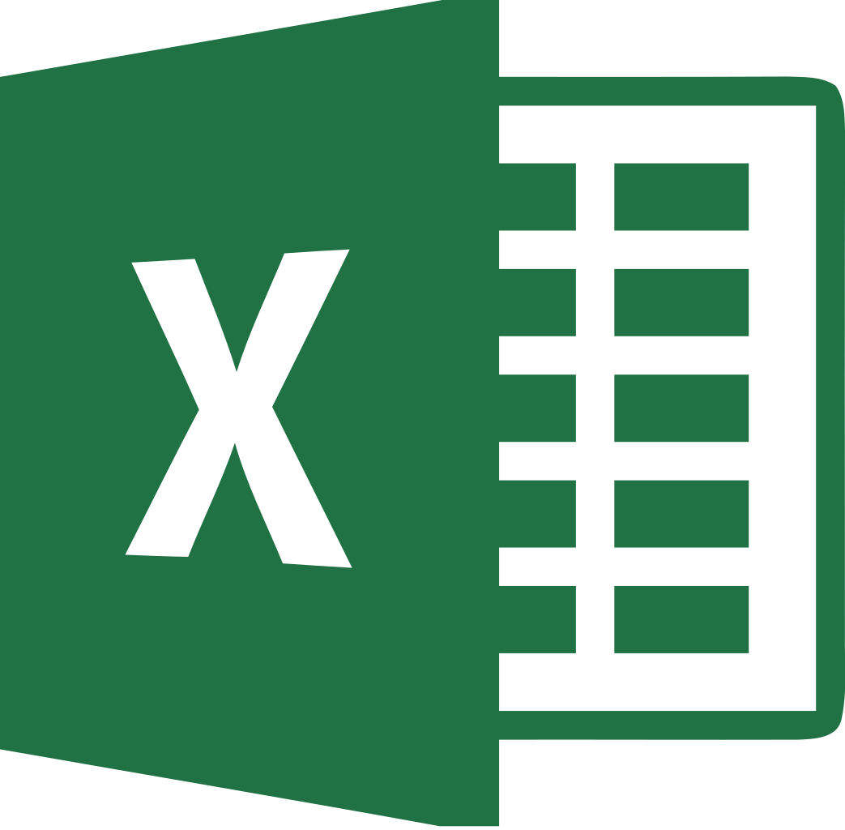
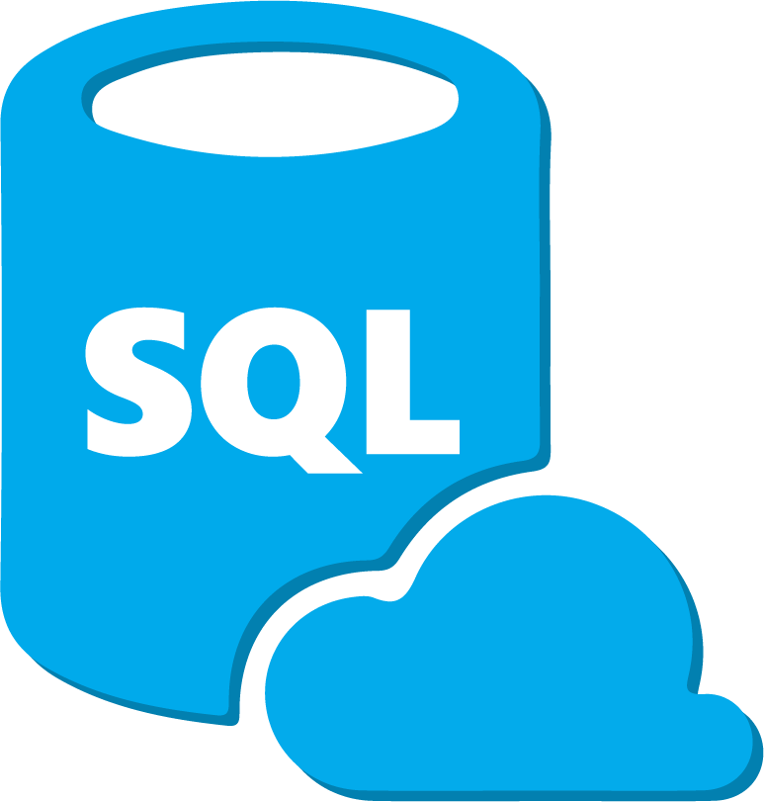



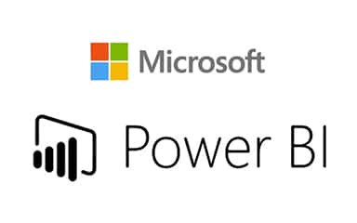

Communication
Store Telling

Slide 3
Data filters, functions
Formulas
Charts and plots
Pivot table, transpose
Vlookup
VBA macros
Allows you to do quick data analysis without having to write code

Slide 4
Basics of relational database and structured query language (SQL)
Query and update data: select, where, insert, update clause
Groupby, orderby, joins, views
Notes:
https://www.khanacademy.org/computing/computer-programming/sql
https://www.youtube.com/playlist?list=PL08903FB7ACA1C2FB (First 12)

Slide 6
Variables, numbers
Strings, lists, dictionaries
For loop, if condition
Functions
Read/write file
Basics understanding of modules
Notes:
Python: https://www.youtube.com/playlist?list=PLeo1K3hjS3usILfyvQlvUBokXkHPSve6S
SAS: https://www.youtube.com/watch?v=-31TLJt1ZPw
R: https://www.edx.org/course/data-science-r-basics
https://www.edx.org/course/introduction-to-r-for-data-science-2

Slide 7


Notes:
https://www.youtube.com/playlist?list=PLyD1XCIRA3gQmN73dHwQWr4R08ABZFMtZ
https://www.youtube.com/playlist?list=PL6_D9USWkG1C4raCOTlTf_oq4XnNNNtm9
https://www.edx.org/course/analyzing-and-visualizing-data-with-power-bi-2

Slide 8

Thanks Sumitkumar Sain ☺
Senior Data Analyst
exl service,
India

Slide 9
Story Telling
Notes:
https://www.edx.org/course/analytics-storytelling-for-impact-2

Slide 10


Data Cleaning and Exploration
Series and dataframe basics
Create dataframe from csv/excel/json
Handle missing data, fillna, dropna
groupby
merge, concat dataframes
Notes:
https://www.youtube.com/playlist?list=PLeo1K3hjS3uuASpe-1LjfG5f14Bnozjwy

Slide 11


Data is clean now, Yay!!!
Reference: quora.com

Slide 12



IDE: Integrated Development Environment

Slide 13


Line chart, bar chart, pie chart
Histograms
Axes labels, legend, grid
Scatter plot
Notes:
https://www.youtube.com/playlist?list=PLeo1K3hjS3uu4Lr8_kro2AqaO6CFYgKOl

Slide 14
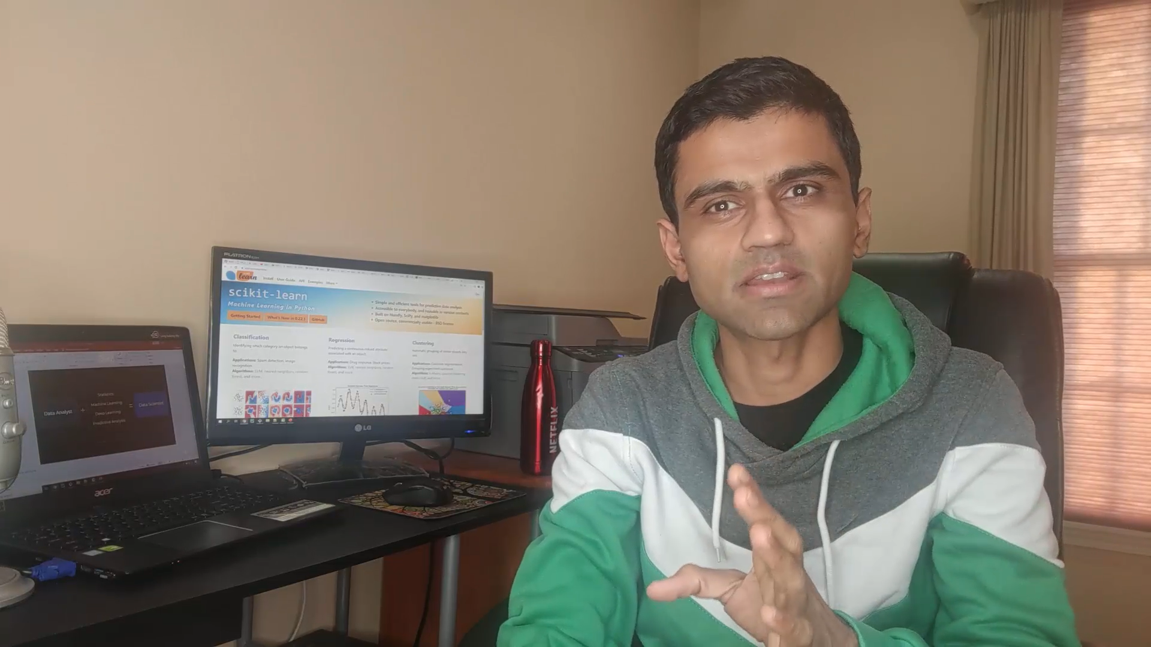
Learn Data Analyst Skills For Free
Notes:
https://www.edx.org/course/analytics-storytelling-for-impact-2

